Slide 1
Azure Identity Management and Microsoft Graph

Slide 2
What is Identity Management?
Notes:
Identity and Access Management (IAM) is an important part of securing an application - particularly one that is exposed externally. An IAM solution allows users to authenticate, verifying to a system or application who they are; and allows that system to determine the actions each user is authorized to perform.

Slide 3
Authentication
Proof that someone is who they say they are
An application can authenticate an account, or it can trust another authority to authenticate

Slide 4
Authorization
Determine if account has permission to perform an action on an object

Slide 5
What is Microsoft Graph?
Notes:
Microsoft Graph (MS Graph) provides a REST API that allows you to access and manage many Active Directory (AD) objects, including information about users and their organizations. Microsoft Graph provides an API that allows you to read and write objects in Azure and Microsoft 365 objects. Examples include accessing and maintaining information on users, calendars, Teams, and devices.

Slide 6
MS Graph APIs
Example:
GET https://graph.microsoft.com/v1.0/users
Retrieves a list of users from Azure Active Directory
POST /users/{userid}/calendar/events
Creates a new event in a user’s calendar
API Reference:
https://learn.microsoft.com/en-us/graph/api/overview
Notes:
You can call the Graph API by sending a POST, PUT, or GET request to a set of endpoints at https://graph.microsoft.com. These endpoints are documented at https://learn.microsoft.com/en-us/graph/api/overview
Some of these requests require sending some data in the HTTP body and all of them require sending data in the HTTP header. One common method of authentication is to send a Bearer Token in the header of each HTTP request. A JSON Web Token (JWT) is a type of Bearer Token issued by an identity provider, such as Azure Active Directory (AAD). It verifies the identity of the person or service making the API call, and it can contain information about that identity.

Slide 7
MS Graph and Identity Management
API runs as an account identity
That identity must be authenticated
That identity must have permission to perform actions in the API call

Slide 8
Workflow
Register App
with
Azure Active Directory
Tenant ID
Application ID
Client Secret
Admin grants permissions
Generate Token
Call MS Graph API
Notes:
Microsoft Graph requires some work ahead of time. The API call runs under an account and that account must be authenticated. One way to authenticate is with a Bearer Token. The account also must have permissions to perform the actions of the API (for example, it must have permission to Read Users when making a call to do this.)
Generating a Token requires information that requires registering an application.
These dependencies and prerequisites are shown in this slide.

Slide 9
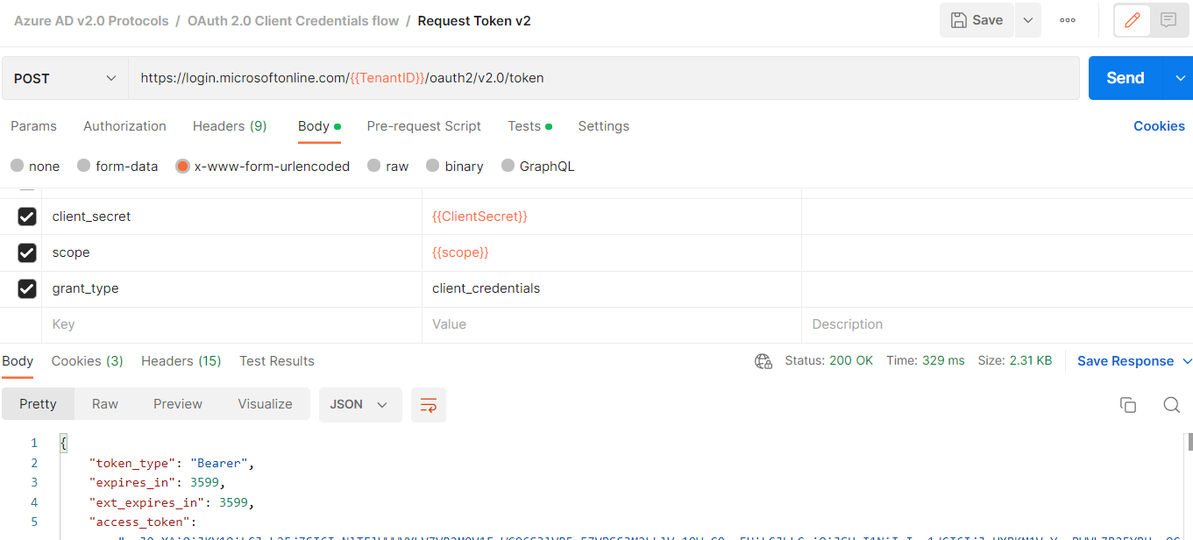
A Useful Tool
Click to Send HTTP Request
HTTP
Verb
URL
Endpoint
Querystring
Parameters
HTTP
Request
Headers
HTTP
Request
Body
Response
Status
Code
Response
Body
https://www.postman.com/
Notes:
Postman is a free cross-platform tool that makes it easy to make REST calls without writing code. The graphical interface allows you to set the URL and Verb of your HTTP request and add data to querystring parameters, the Request Body, and the Request Header.
After clicking the [Send] button, the response displays in the bottom half of the screen.

Slide 10
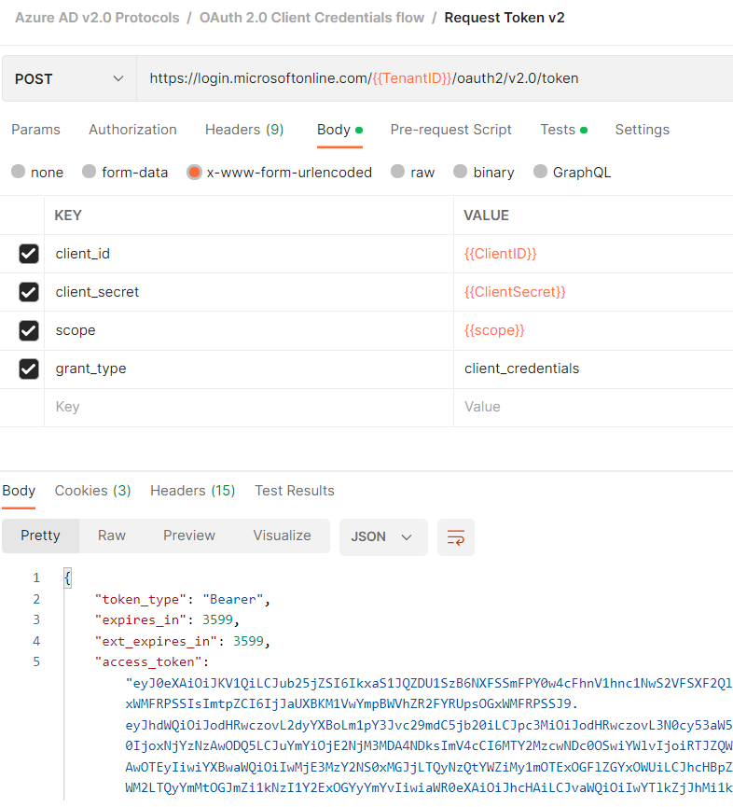
Generating a Bearer Token
Notes:
You can generate a JWT Bearer Token by POSTing form data to an HTTP endpoint. In order to do this, you will need 3 pieces of information:
-Tenant ID
-Client ID
-Client Secret
You can find the Tenant ID in your Azure subscription's Active Directory tenant.
To get the Client ID and Client Secret, you will need to register your application with Azure Active Directory.
We will return to the Bearer Token generation after I show you how to find these three pieces of information.

Slide 11
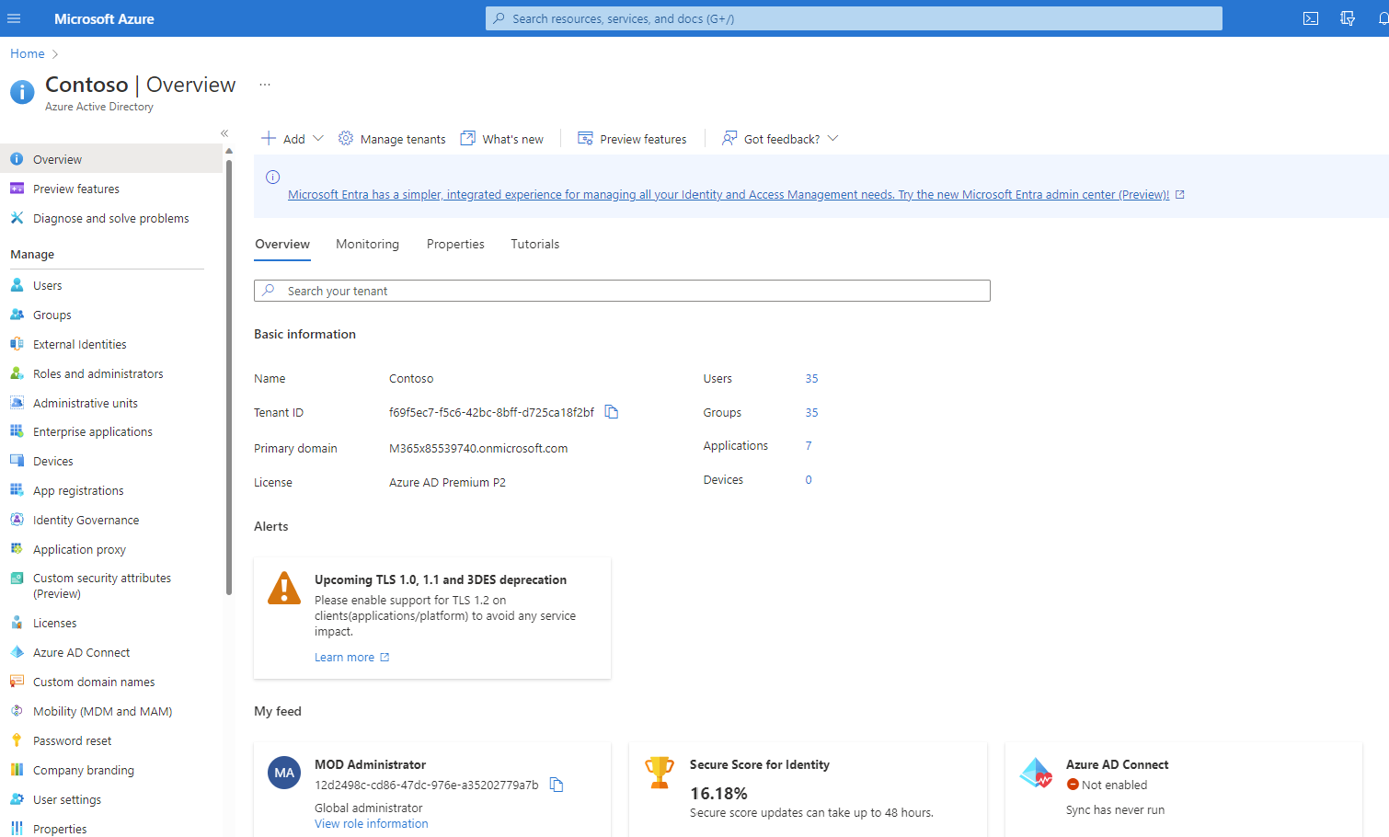
Azure Active Directory
https://portal.azure.com
Notes:
To use Azure Active Directory as an Identity Provider, you will need an Azure subscription.
Log into the Azure Portal (https://portal.azure.com), search for and select Azure Active Directory (Fig. 1) to display the Azure Active Directory "Overview" blade
You can find the Tenant ID for this subscription on the "Overview" blade. Copy and save this value. You will need it later.

Slide 12
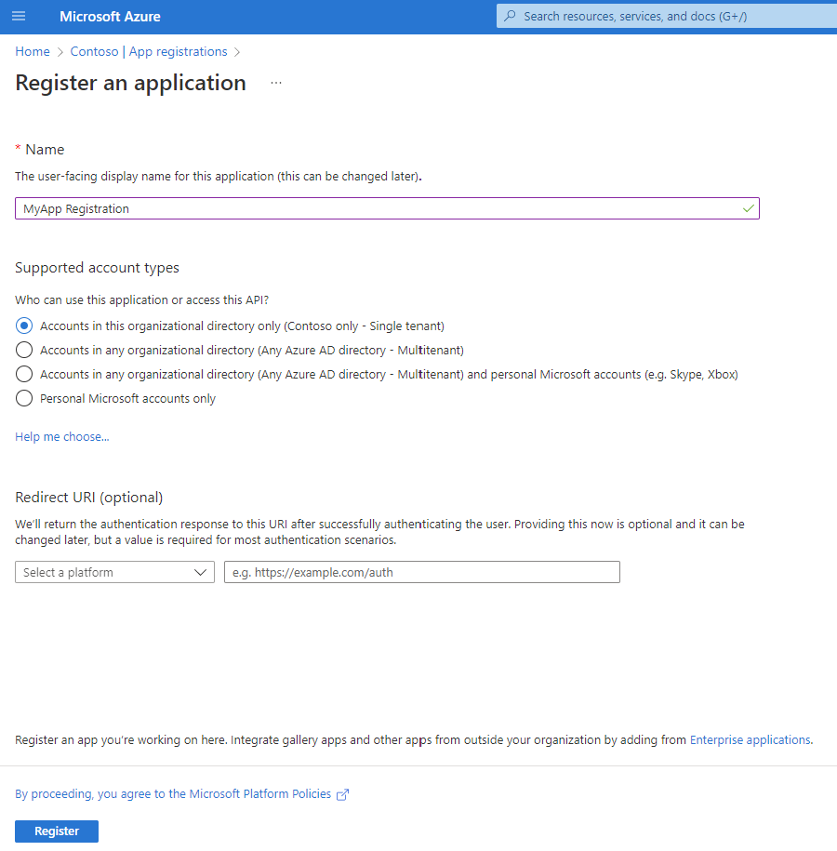
Application Registration
Notes:
Click the [App registrations] button in the left menu to display the "App registrations" blade.
Click the [New registration] button to display the "Register an application" dialogue.

Slide 13
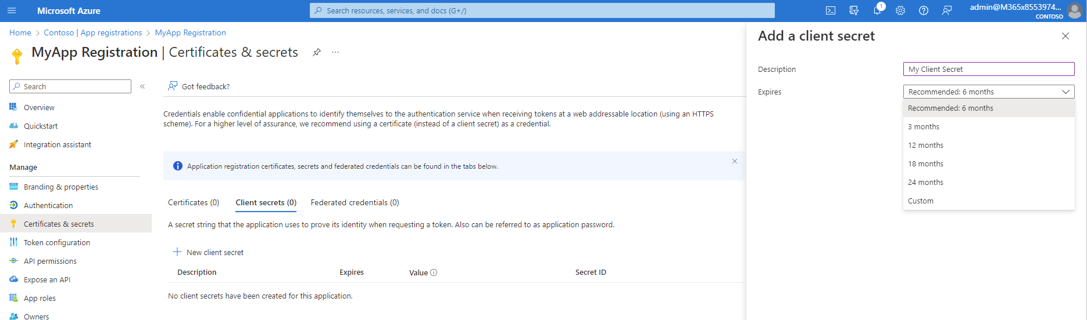
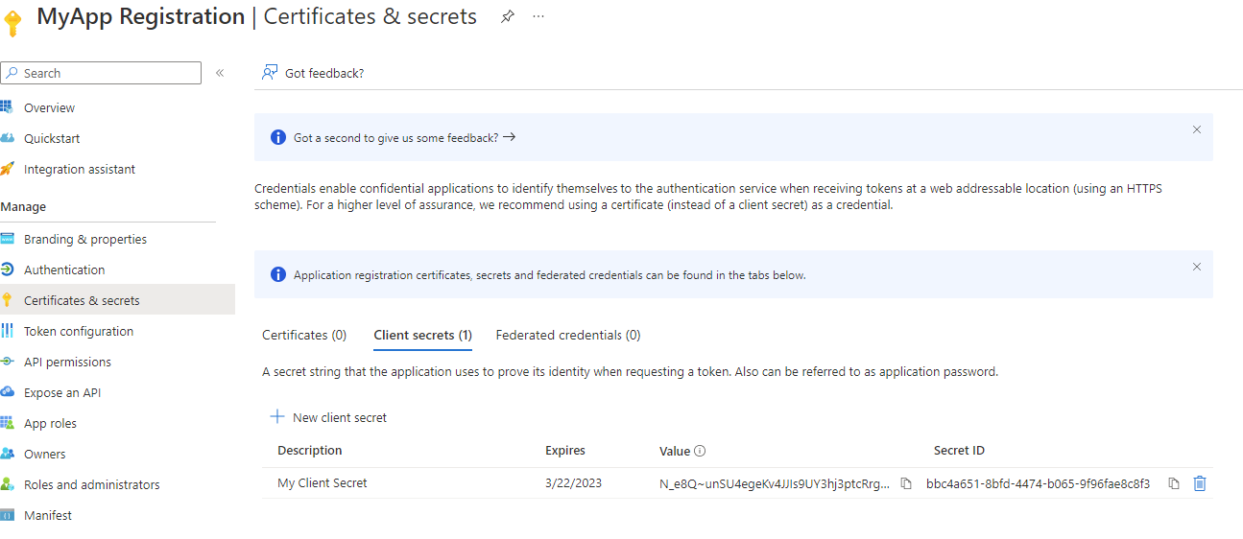
Client Secret
Client Secret
Value
Notes:
After registering an application, Click the [Certificates & secrets] button to display the "Certificates & secrets" blade
Copy and save the "Value". You will need it later.

Slide 14
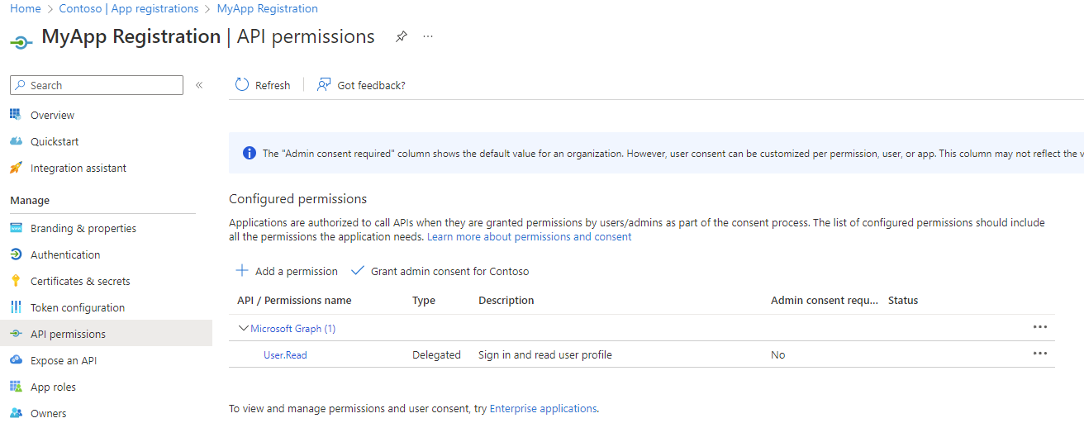
Granting Permissions
Notes:
In order for an account to successfully call the Graph API, that account must have permissions to perform the actions specified by that API. An AD Administrator is responsible for granting those permissions. Here are the steps to take while logged into Azure as an AD Administrator for the subscription involved.

Slide 15
Workflow
Register App
Tenant ID
Application ID
Client Secret
Admin grants permissions
Generate Token
Call MS Graph API
Notes:
Microsoft Graph requires some work ahead of time. The API call runs under an account and that account must be authenticated. One way to authenticate is with a Bearer Token. The account also must have permissions to perform the actions of the API (for example, it must have permission to Read Users when making a call to do this.)
Generating a Token requires information that requires registering an application.
These dependencies and prerequisites are shown in this slide.

Slide 16
Demo

Slide 17
Thank You!

